Slide 1
Improved Nanopore sequencing accuracy enables ASV-resolved microbial profiling

Slide 2
Moving from Illumina to Nanopore
Sequences
Technology | Typical raw read accuracy | Approx. error rate
Illumina MiSeq | 99.8–99.9%+ | 0.1–0.2%
Nanopore R9.4.1 (HAC) | 94–97% | 3–6%
Nanopore R10.4.1 (HAC) | 97–99% | 1–3%
Nanopore R10.4.1 (SUP) | 99–99.75% | 0.25–1%
V1-V3 region ~500 bp
V1-V8 region ~1400 bp
Full operon >4000 bp
Low chance of perfect reads

Slide 3
Moving from Illumina to Nanopore
Sequences
Technology | Typical raw read accuracy | Approx. error rate
Illumina MiSeq | 99.8–99.9%+ | 0.1–0.2%
Nanopore R9.4.1 (HAC) | 94–97% | 3–6%
Nanopore R10.4.1 (HAC) | 97–99% | 1–3%
Nanopore R10.4.1 (SUP) | 99–99.75% | 0.25–1%
Recovery of 0 ASVs
V1-V3 region ~500 bp
V1-V8 region ~1400 bp
Full operon >4000 bp
Low chance of perfect reads

Slide 4
Using a mapping approch
Database
Sequences
Recovery of 0 ASVs
Mapping the sequences to a database
Sequences in the database

Slide 5
Using a mapping approch
Database
Sequences
Recovery of 0 ASVs
Mapping the sequences to a database
Sequences in the database

Slide 6
Using a mapping approch
Database
Sequences
Recovery of 0 ASVs
Mapping the sequences to a database
Sequences in the database

Slide 7
Using a mapping approch
Database
Mapping is often performed at lower identity threshold to accommodate sequencing errors
→ Inflates alpha diversity
High risk of overclassification
Sequences
Recovery of 0 ASVs
Mapping the sequences to a database
Sequences in the database

Slide 8
Using a mapping approch
Database
Mapping is often performed at lower identity threshold to accommodate sequencing errors
→ Inflates alpha diversity
High risk of overclassification
Sequences
Recovery of 0 ASVs
Mapping the sequences to a database
Not present in the database
Sequences in the database

Slide 9
Using a mapping approch
Database
Mapping is often performed at lower identity threshold to accommodate sequencing errors
→ Inflates alpha diversity
High risk of overclassification
Sequences
If no match to the database
Sequences will be unclassified
Novelty not detected
Recovery of 0 ASVs
Mapping the sequences to a database
Not present in the database
Sequences in the database

Slide 10

Also used in our nanopore pipeline
Mapping is often performed at lower identity threshold to accommodate sequencing errors
→ Inflates alpha diversity
High risk of overclassification
Previous Nanopore pipeline
Nanopore reads
Quality filtering
If no match to the database
Sequences will be unclassified
Novelty not detected
Minimap2 to the MiDAS database (ID=95%)
Abundance table

Slide 11
Issues with nanopore amplicon workflow
Current workflows:
Alignment based
OTU based
Rely heavily on the database
Novel taxa is not discovered
Alignment based workflows tend to overclassify
Goal: Get back to ASVs to better catch novelty
Current Nanopore pipeline
Nanopore reads
filtlong
Mimimap2 to the MiDAS database (ID=95%)
Abundance table

Slide 12
Improvement of Nanopore reads
Technology | Typical raw read accuracy | Approx. error rate
Illumina MiSeq | 99.8–99.9%+ | 0.1–0.2%
Nanopore R9.4.1 (HAC) | 94–97% | 3–6%
Nanopore R10.4.1 (HAC) | 97–99% | 1–3%
Nanopore R10.4.1 (SUP) | 99–99.75% | 0.25–1%

Slide 13
Improvement of Nanopore reads
Technology | Typical raw read accuracy | Approx. error rate
Illumina MiSeq | 99.8–99.9%+ | 0.1–0.2%
Nanopore R9.4.1 (HAC) | 94–97% | 3–6%
Nanopore R10.4.1 (HAC) | 97–99% | 1–3%
Nanopore R10.4.1 (SUP) | 99–99.75% | 0.25–1%
Can we generate ASVs based on the improved quality of nanopore reads?

Slide 14
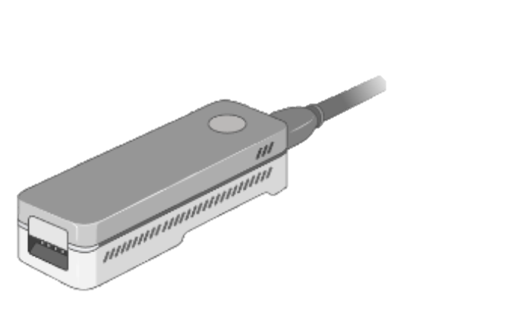



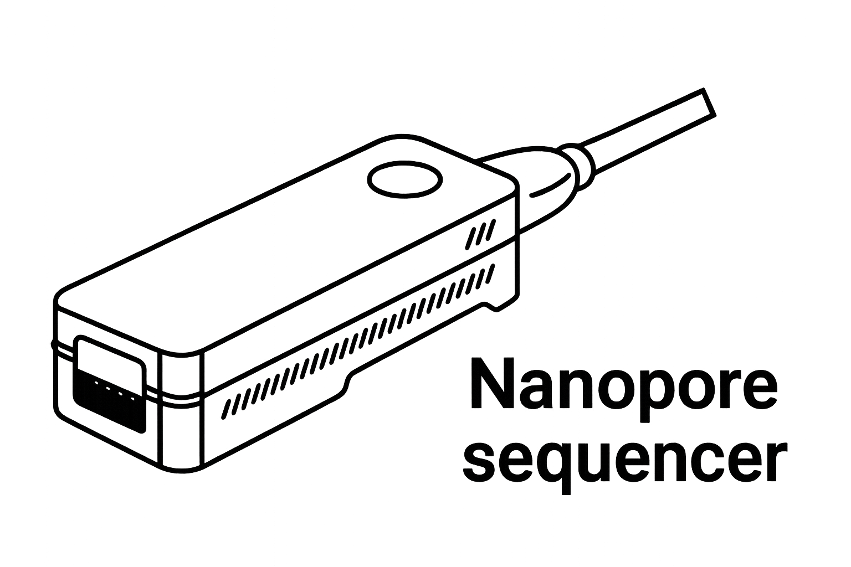
Methods
Stefania
Rasmus
Kasper

Slide 15
Research questions
Can we generate ASVs based on the current quality of nanopore reads?
Can we use the tools developed for Illumina and PacBio?
What sequencing depth is required and what effect has different primers?
Can we find the correct sequences in a mock community
Can we do this for complex samples? How does it compare to PacBio – used as our reference

Slide 16
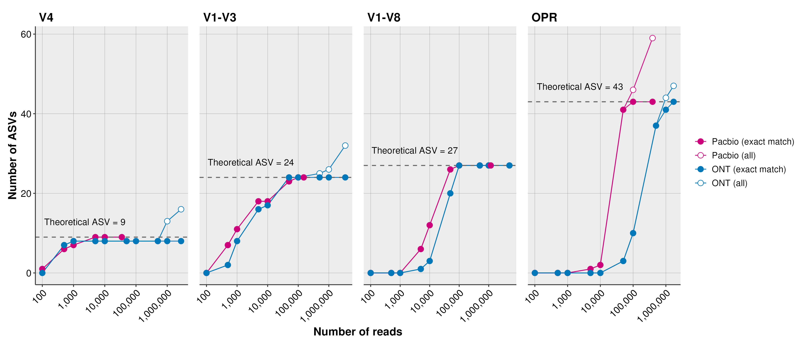
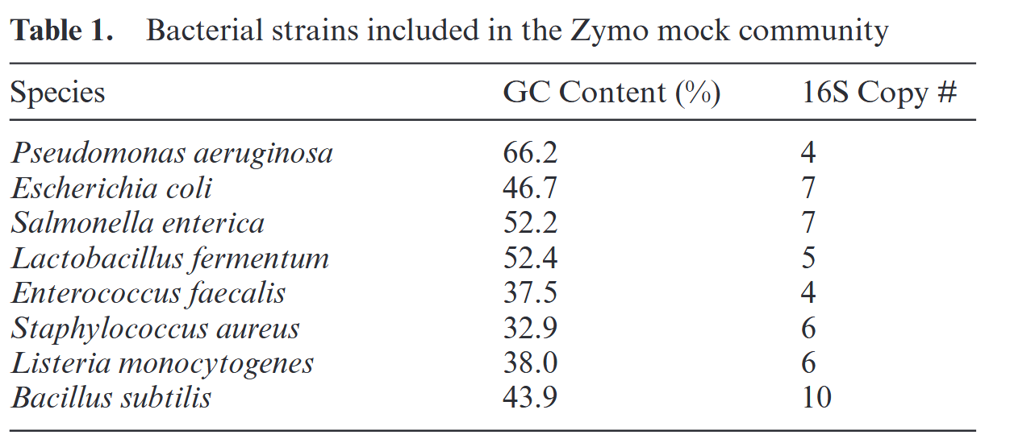
Identified ASVs Zymo Mock
Reads

Slide 17
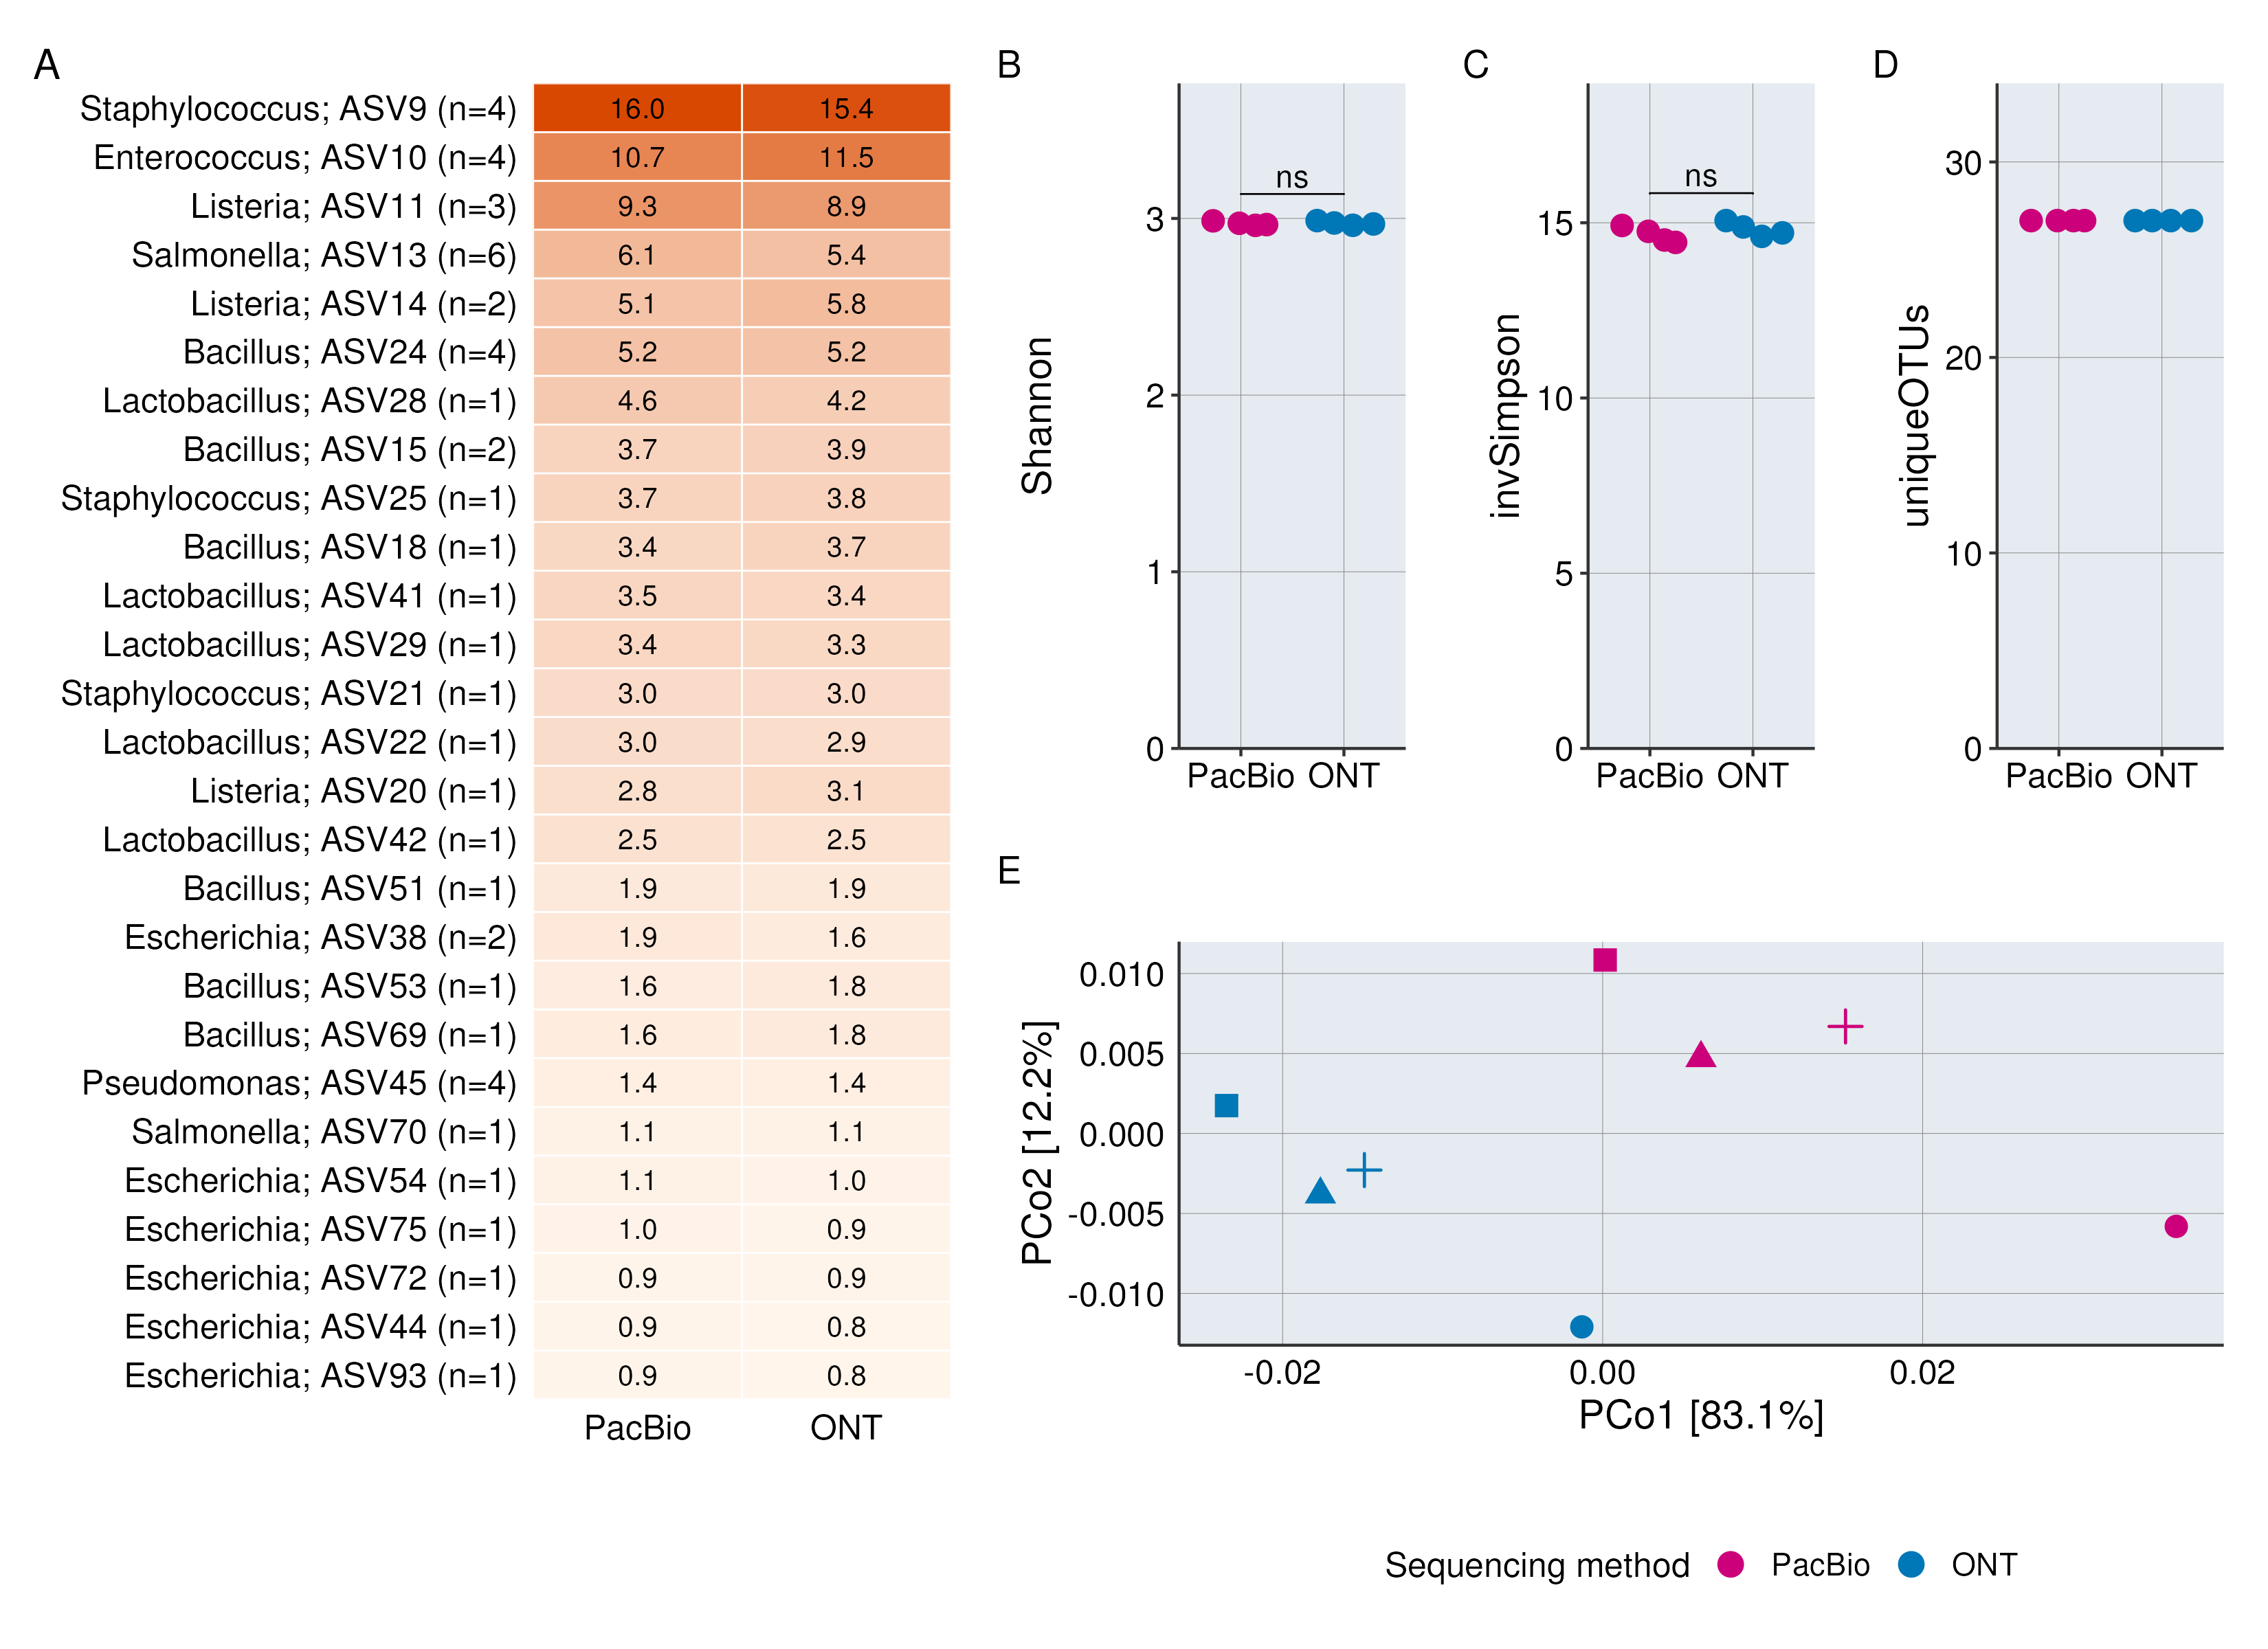
Alpha-diversity: Zmock
V1V8: 100,000 reads

Slide 18

Can we generate ASVs in complex communities?

Slide 19
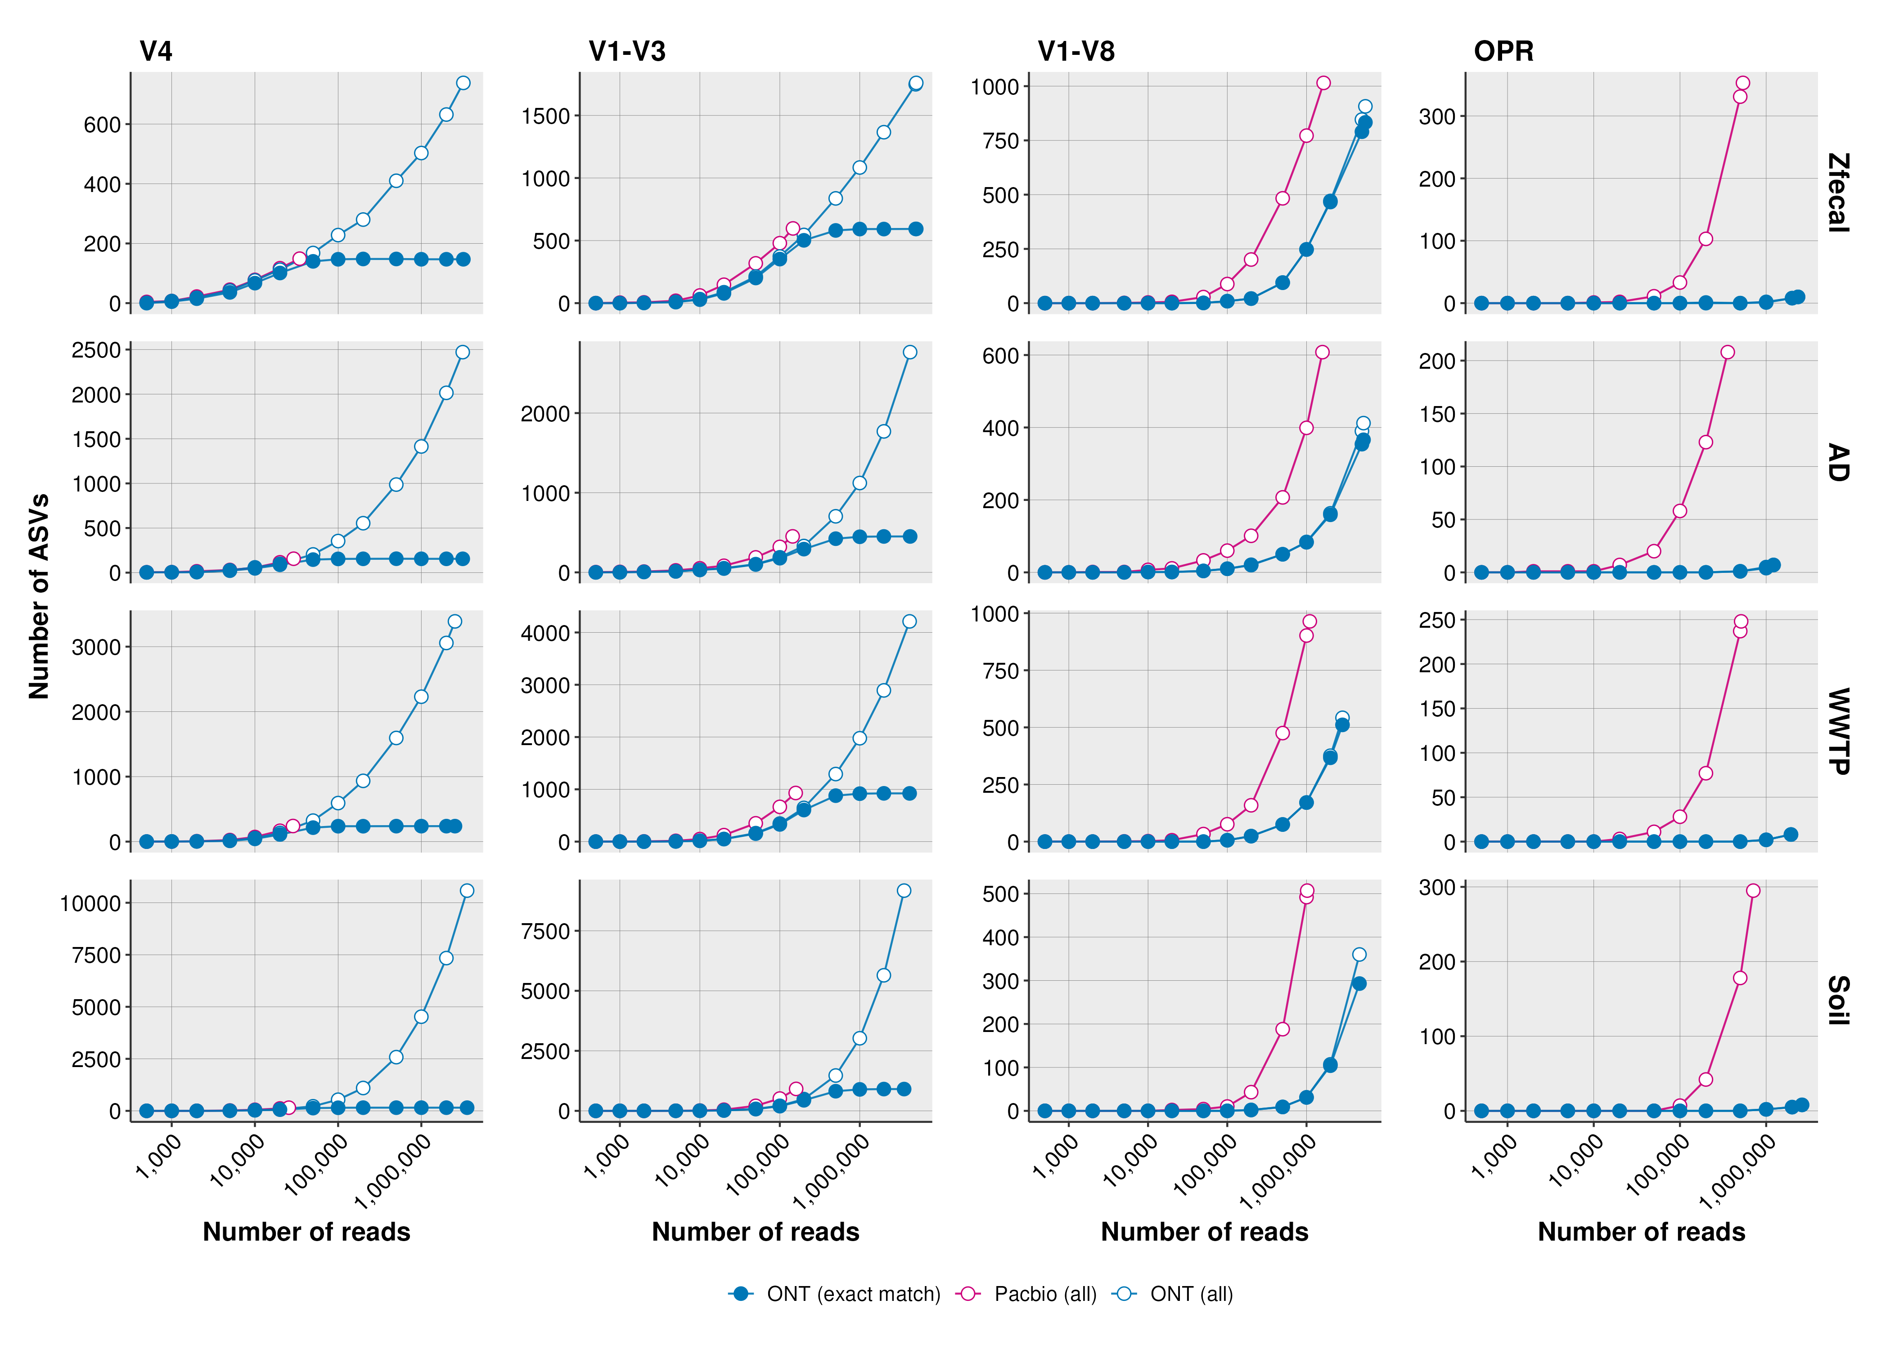
Identified ASVs in activated sludge
V4
Activated sludge
from WWTP
Number
of ASVs
Reads

Slide 20
Identified ASVs in activated sludge
Number of ASVs
ONT needs more reads than PacBio:
V4: 1-2 ×
V1-V3: 2–3×
V1V8: 4.1–5.6×
OPR: 25–42×
(to generate 100 ASVs)

Slide 21
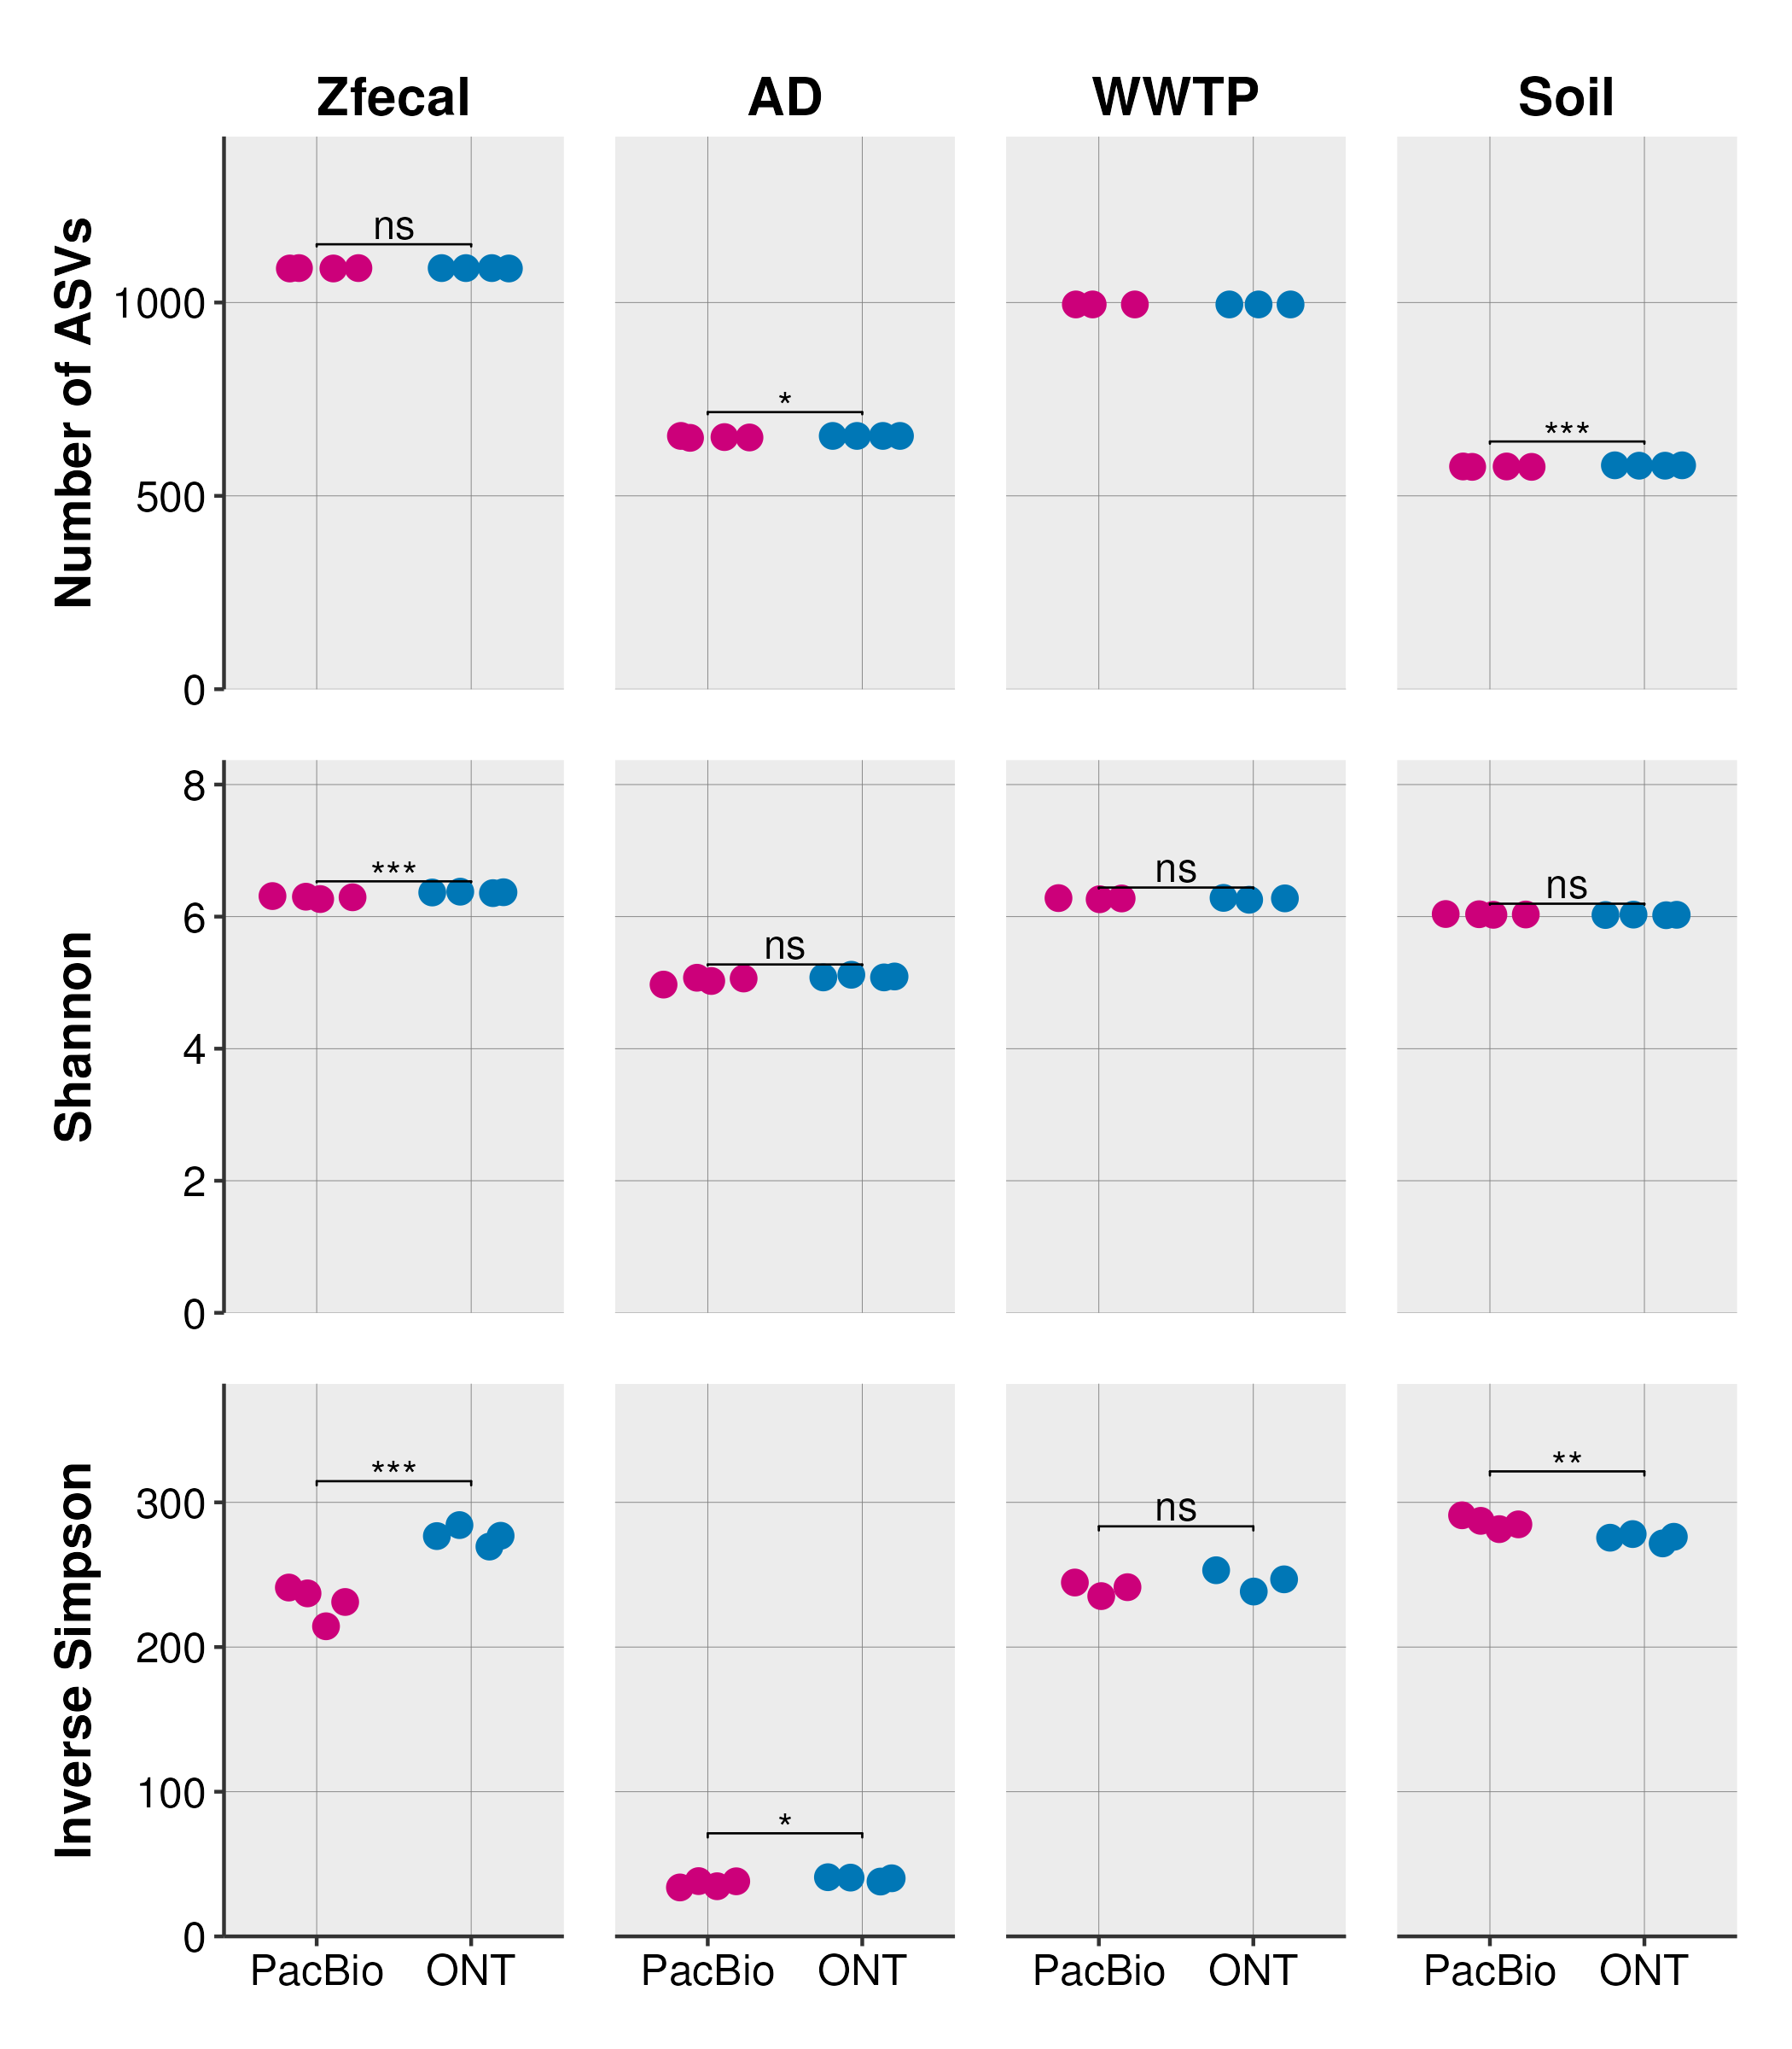
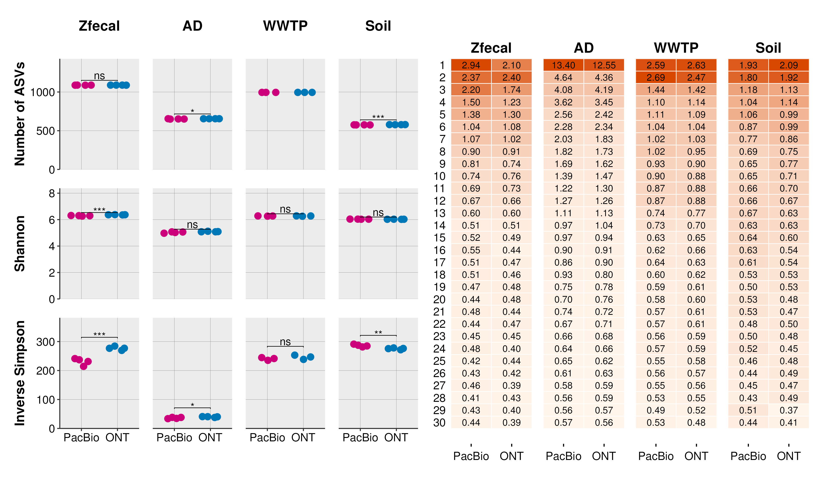

Alpha-diversity in activated sludge
V1V8
Rarefied
Results of a t.test
ns: non-significant
*: p<0.05
**: p<0.01
***: p<0.001
ASV rank

Slide 22
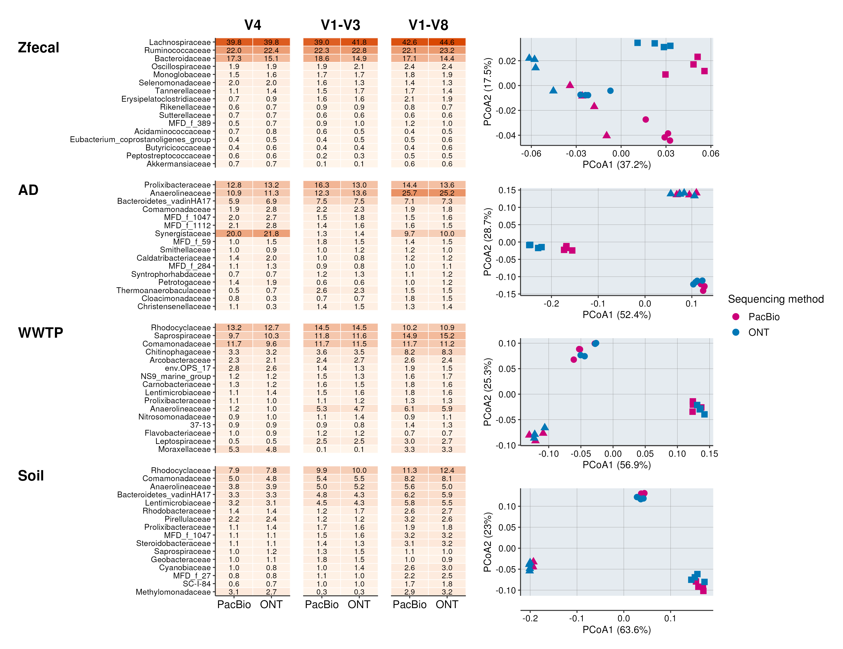
Beta-diversity in activated sludge
ADONIS:
Sequencing method: ns
Primer: R²=0.88, P<0.001

Slide 23
Conclusions
Can we generate ASVs based on the current quality of nanopore reads?
Can we use the tools developed for Illumina and PacBio?
Can we find the correct sequences in a mock community
Can we do this for complex samples? How does it compare to pacbio – used as our reference
What sequencing depth is required and what effect has different primers?
V4: 1-2× ; V1-V3: 2–3× ; V1V8: 4.1–5.6× ; OPR: 25–42× (complex)
YES!

Slide 24
Conclusions
Sequences
Can we generate ASVs based on the current quality of nanopore reads?
Can we use the tools developed for Illumina and PacBio?
Can we find the correct sequences in a mock community
Can we do this for complex samples? How does it compare to pacbio – used as our reference
What sequencing depth is required and what effect has different primers?
V4: 1-2× ; V1-V3: 2–3× ; V1V8: 4.1–5.6× ; OPR: 25–42× (complex)
YES!

Slide 25
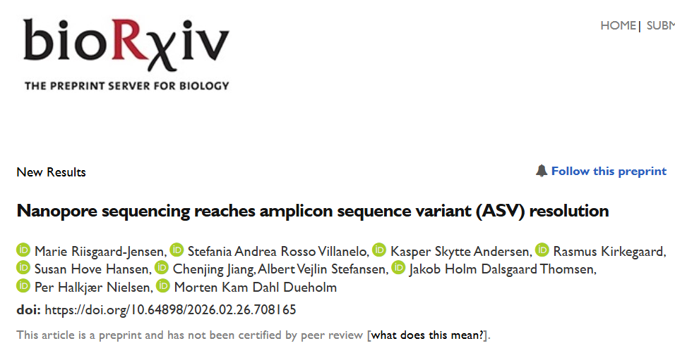
Conclusions
Can we generate ASVs based on the current quality of nanopore reads?
Can we use the tools developed for Illumina and PacBio?
Can we find the correct sequences in a mock community
Can we do this for complex samples? How does it compare to pacbio – used as our reference
What sequencing depth is required and what effect has different primers?
V4: 1-2× ; V1-V3: 2–3× ; V1V8: 4.1–5.6× ; OPR: 25–42× (complex)
YES!

Slide 26
Hands on – Part two
Compare the same data based on pipeline
ASV based:
Pipeline: https://github.com/KasperSkytte/snakemake_usearch
Alignment based (95% identity)
Pipeline: https://github.com/cmc-aau/nanopore_16Samp

Slide 27
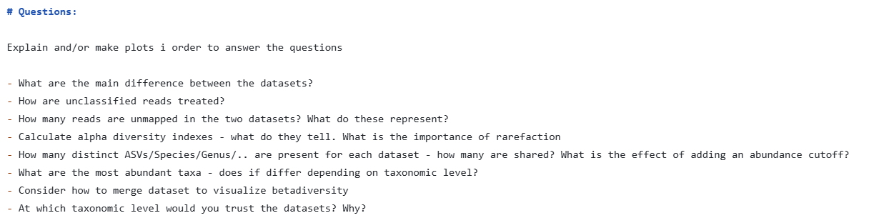
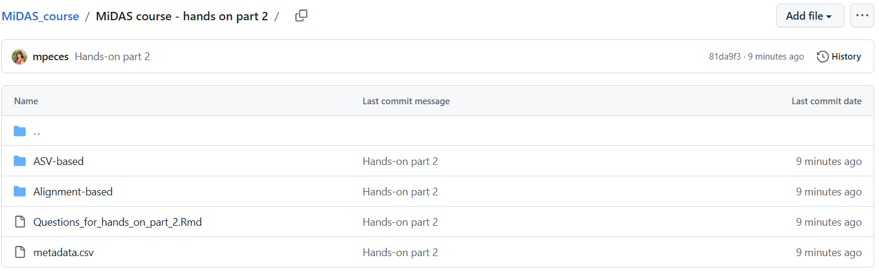
Hands on – Part two
Compare the same data based on pipeline
ASV based:
Pipeline: https://github.com/KasperSkytte/snakemake_usearch
Alignment based (95% identity)
Pipeline: https://github.com/cmc-aau/nanopore_16Samp
Same metadata

